Slide 1
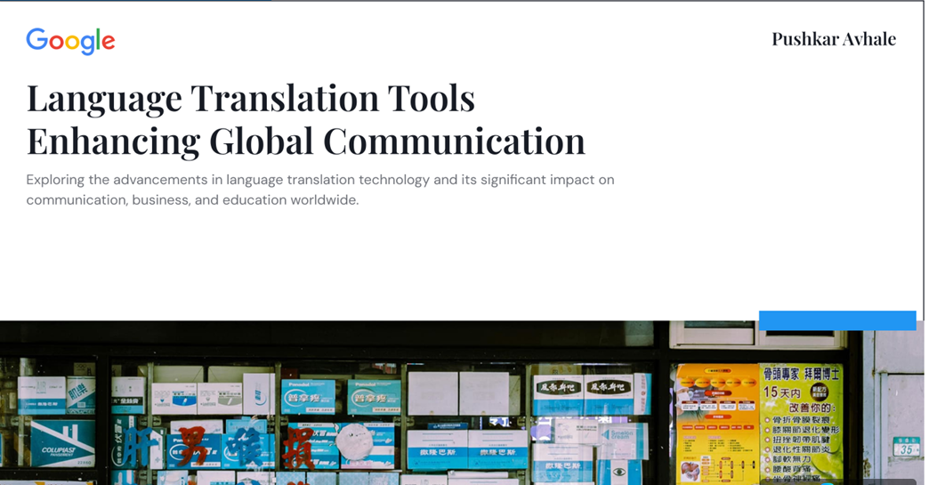

Slide 2
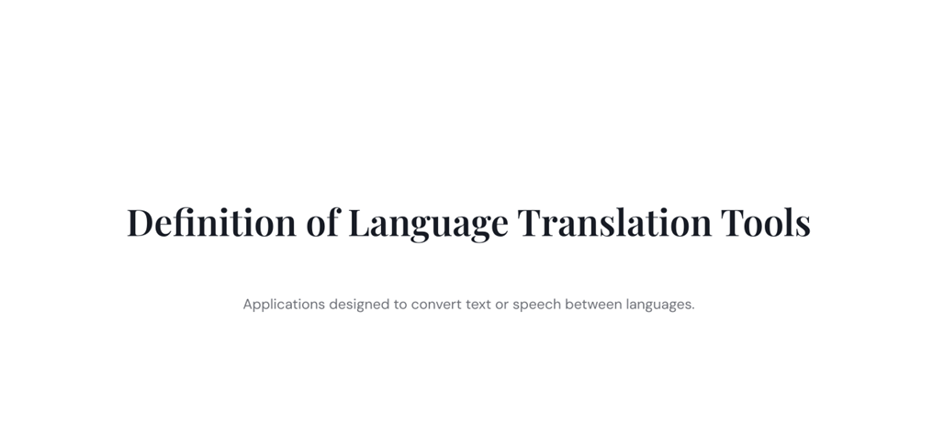

Slide 3
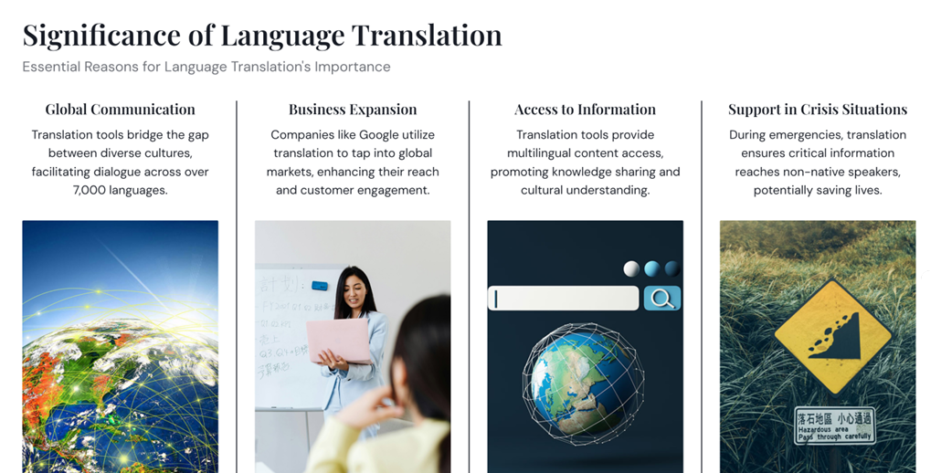

Slide 4


Slide 5
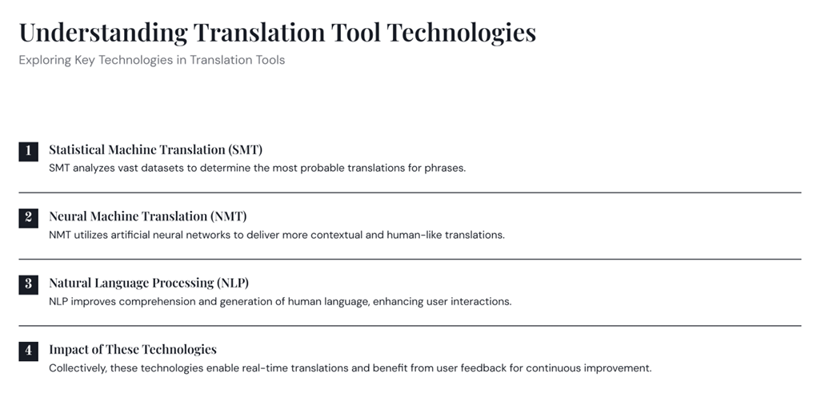

Slide 6
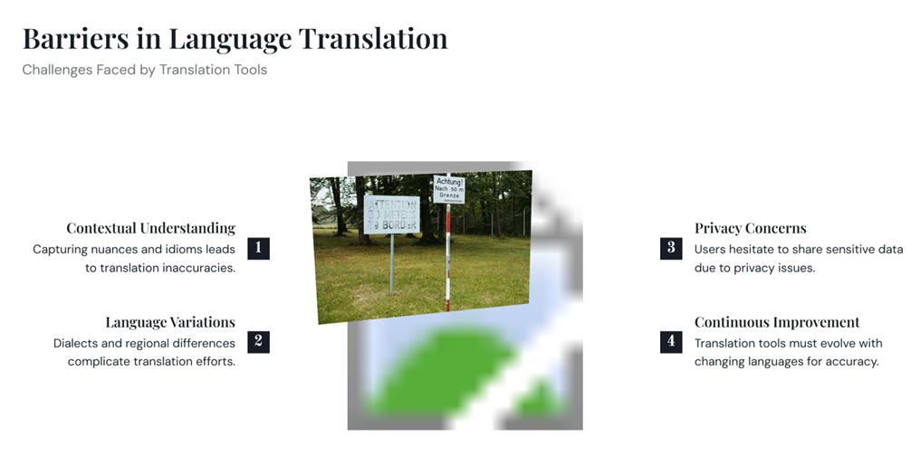

Slide 7
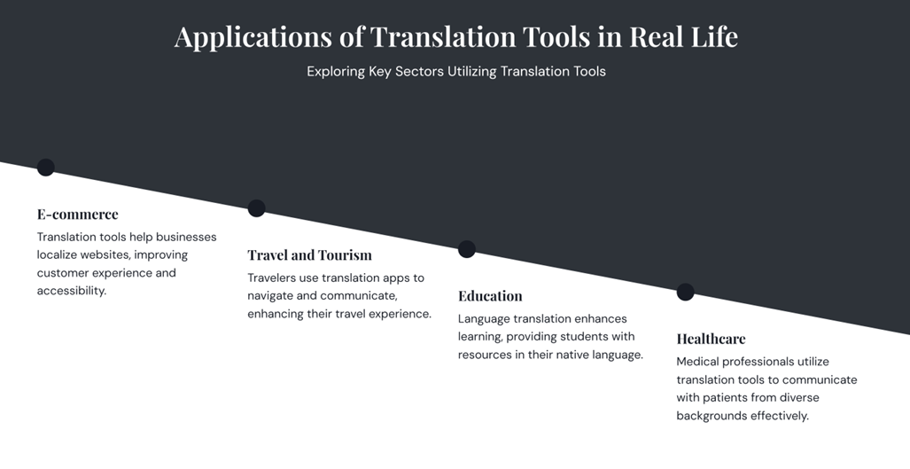

Slide 8
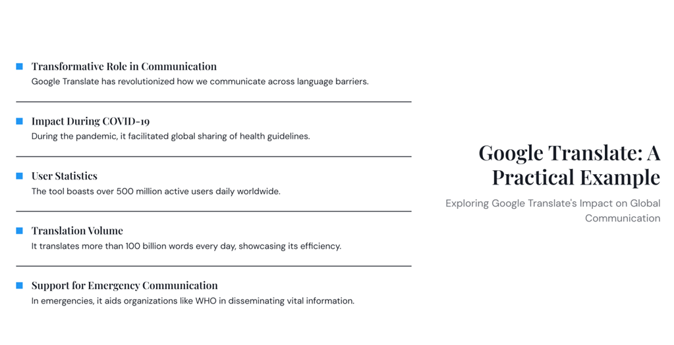

Slide 9
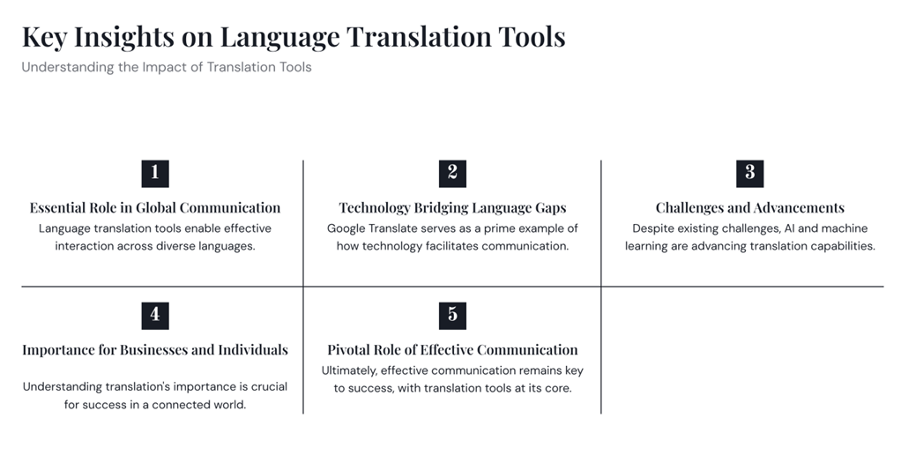

Slide 10


Slide 11
Language Translation tool 1. Google Translate API 2.Microsoft Translator API

Slide 12
Option 1: Using Google Translate API
1. Install Required Script
Pip install googletrans==4.0.0-rc1
2. Write a Python Script
from googletrans import Translatordef translate_text(text, src_lang='auto', dest_lang='en’):
translator = Translator()
translation = translator.translate(text, src=src_lang, dest=dest_lang)
return translation.text

Slide 13
Option 2: Using Microsoft Translator API
1. Get API Key
Sign up on Azure Translator: Microsoft Translator
Get API Key and Endpoint URL
2.Install Required Labrary
Pip install requests
3. Write a Python Script
import requests
import json
def translate_text_microsoft(text, src_lang='auto', dest_lang='en'): subscription_key = "YOUR_AZURE_API_KEY"
endpoint =
"https://api.cognitive.microsofttranslator.com/translate"
location = "YOUR_REGION"
params = {
'api-version': '3.0’,
'from': src_lang,
'to': dest_lang
}
headers = { 'Ocp-Apim-Subscription-Key': subscription_key, 'Ocp-Apim-Subscription-Region': location, 'Content-Type': 'application/json' }
body = [{'text': text}]
response = requests.post(endpoint, params=params, headers=headers, json=body) translation = response.json()
return translation[0]['translations'][0]
['text']

